Slide 1

Bike Store Sales and Performance Analysis
An in-depth review of sales performance and key insights
By: Asaf Chechik

Slide 2
Overview of the Analysis
This analysis reviews sales performance across several dimensions:
- Total revenue and quantity sold
- Yearly and monthly sales trends
- Top customers and customer distribution by state
- Product and brand performance
- Store and staff sales performance

Slide 3
Brand Sales Analysis

Slide 4
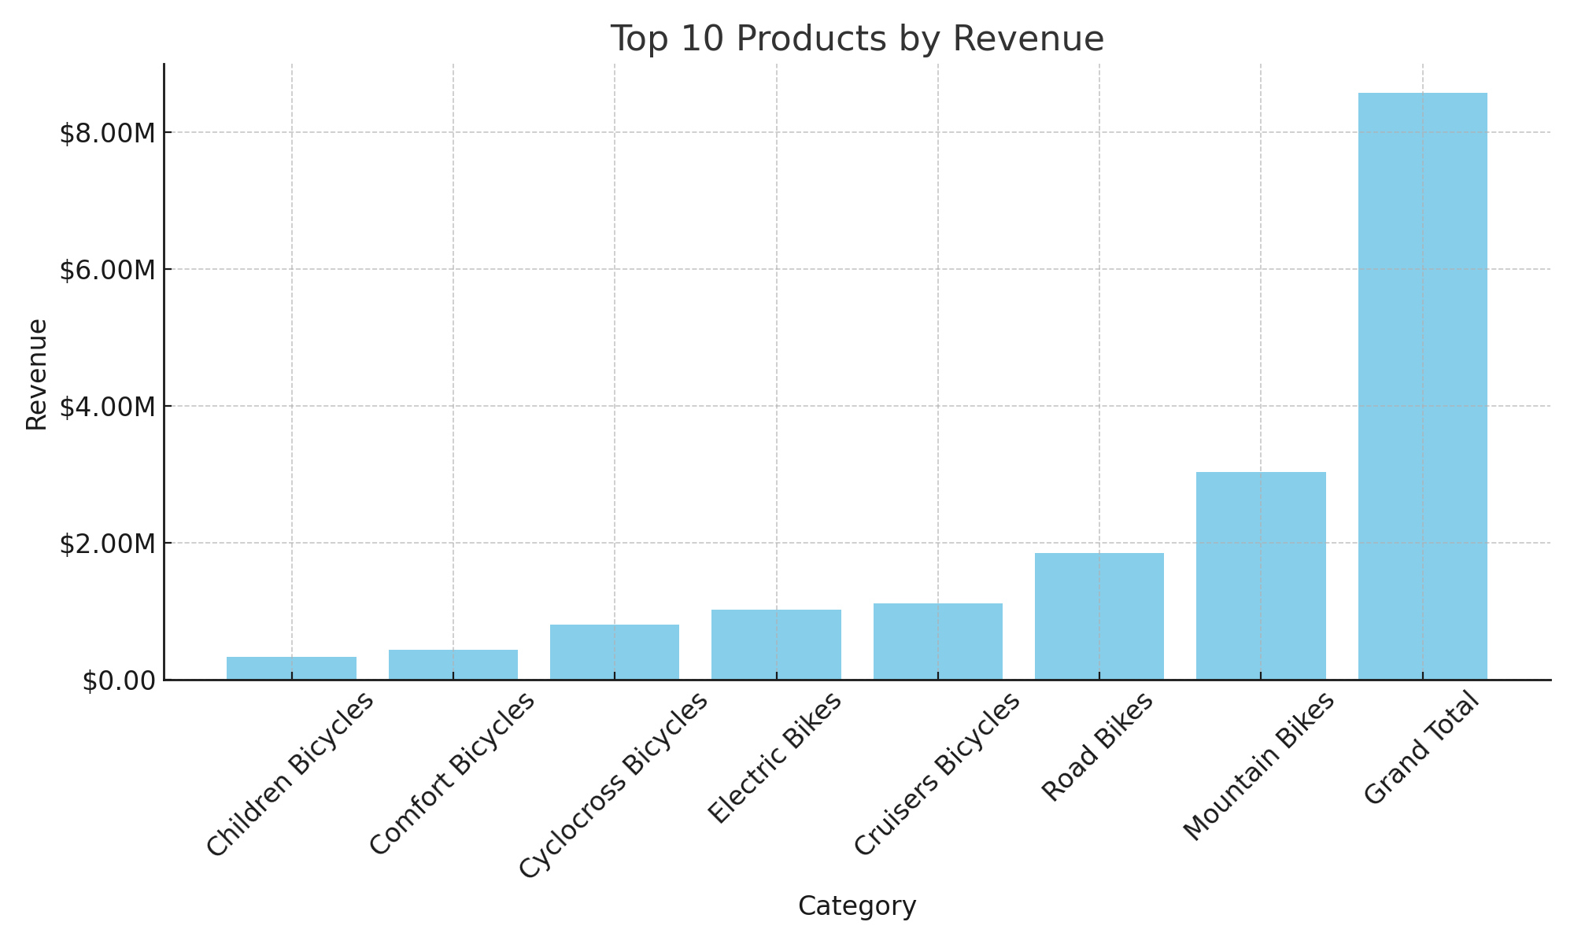
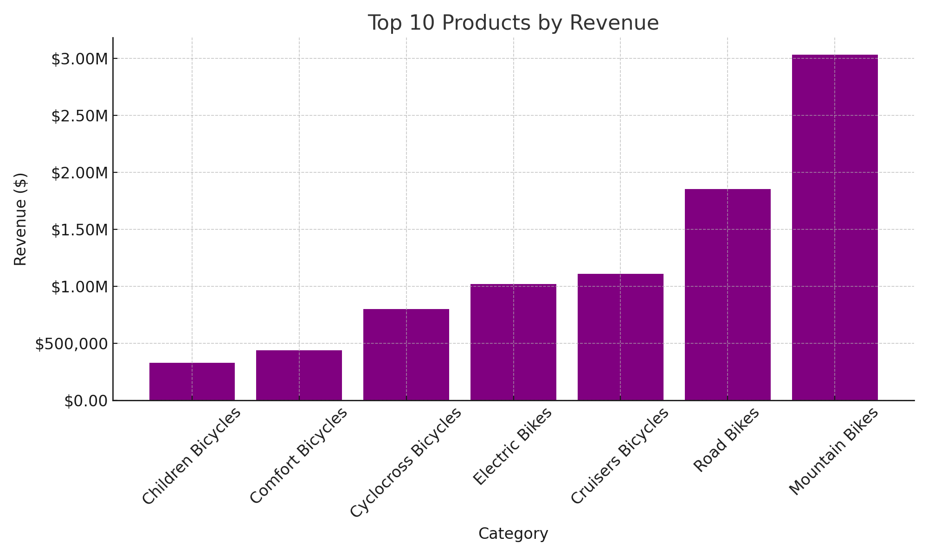
Top 10 Products by Revenue

Slide 5
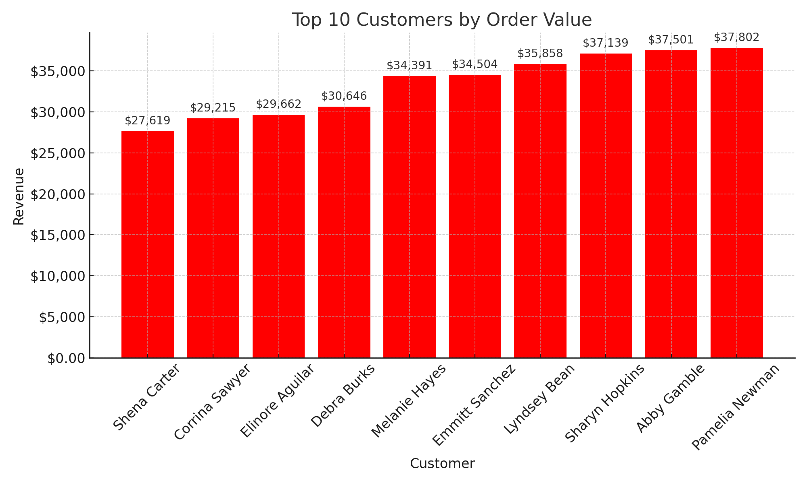
Top 10 Customers by Order Value

Slide 6
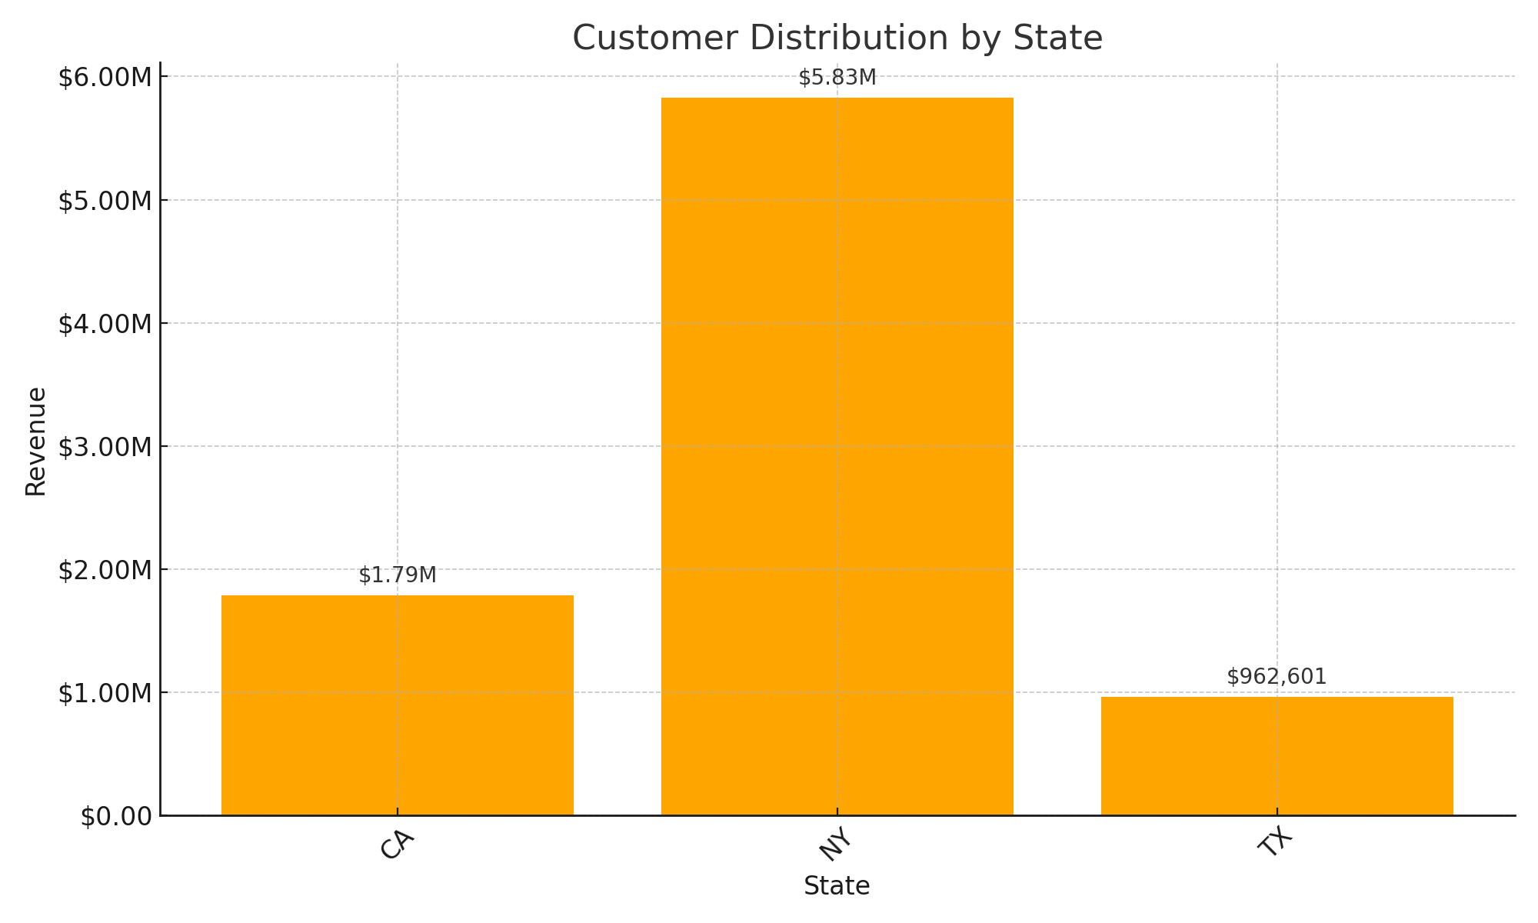
Customer Distribution by State
Insight: New York and California lead in customer distribution and sales performance.

Slide 7
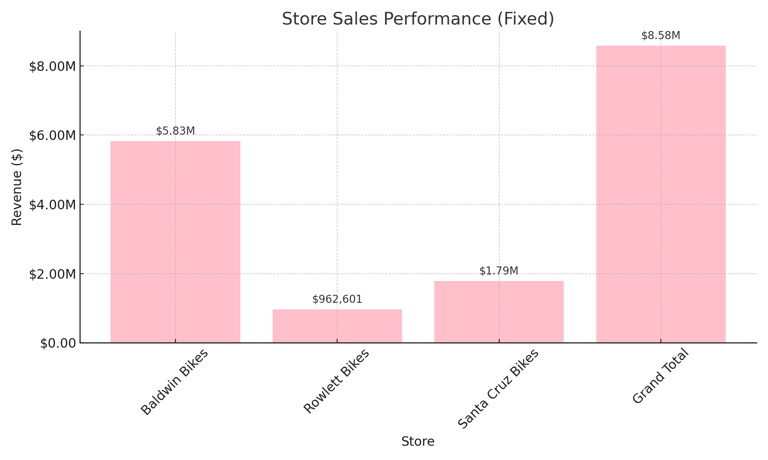
Store Sales Performance

Slide 8
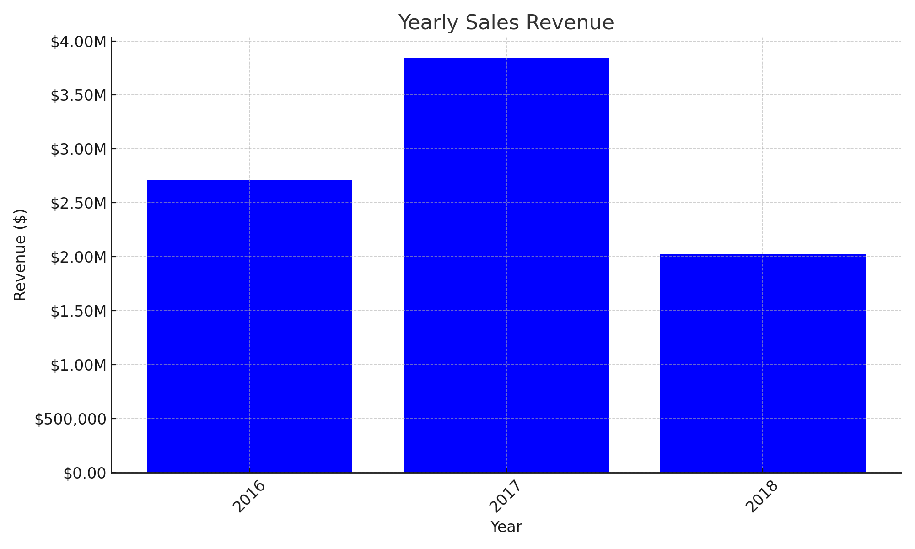
Yearly Sales Revenue

Slide 9
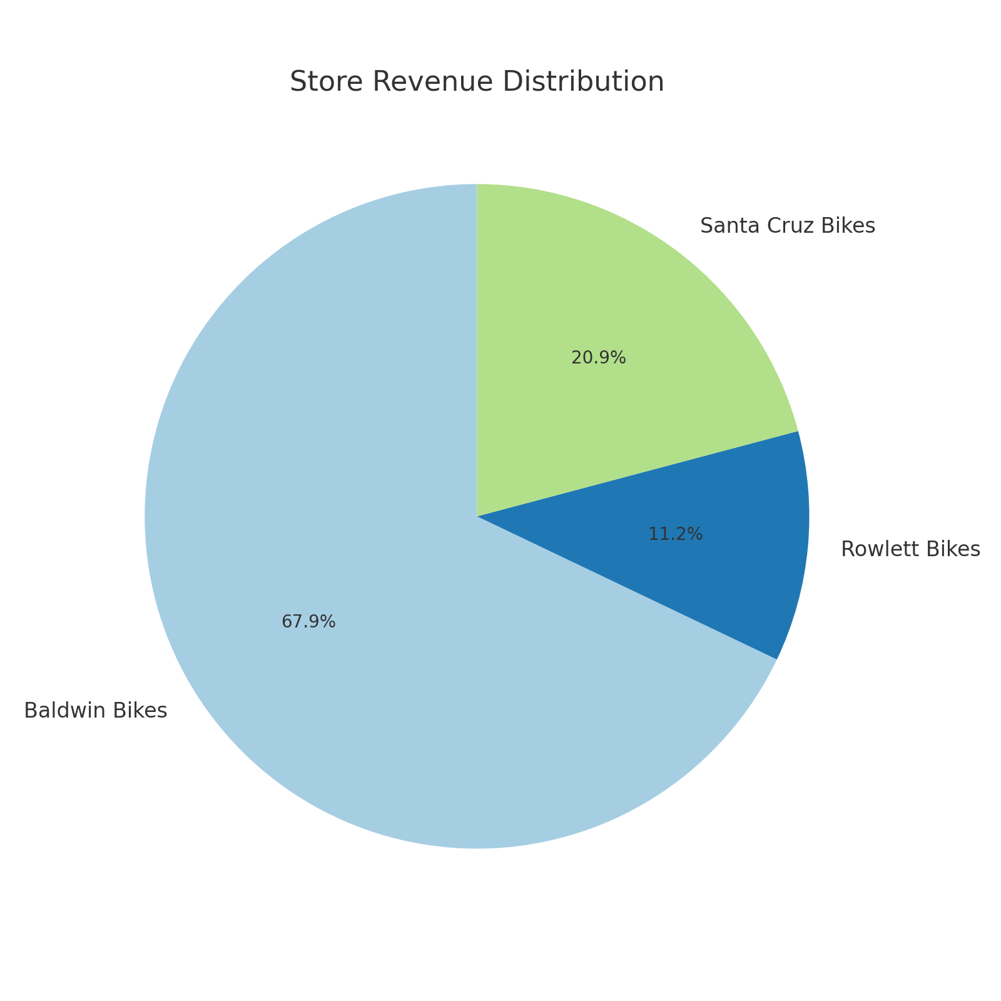
Store Sales Performance

Slide 10
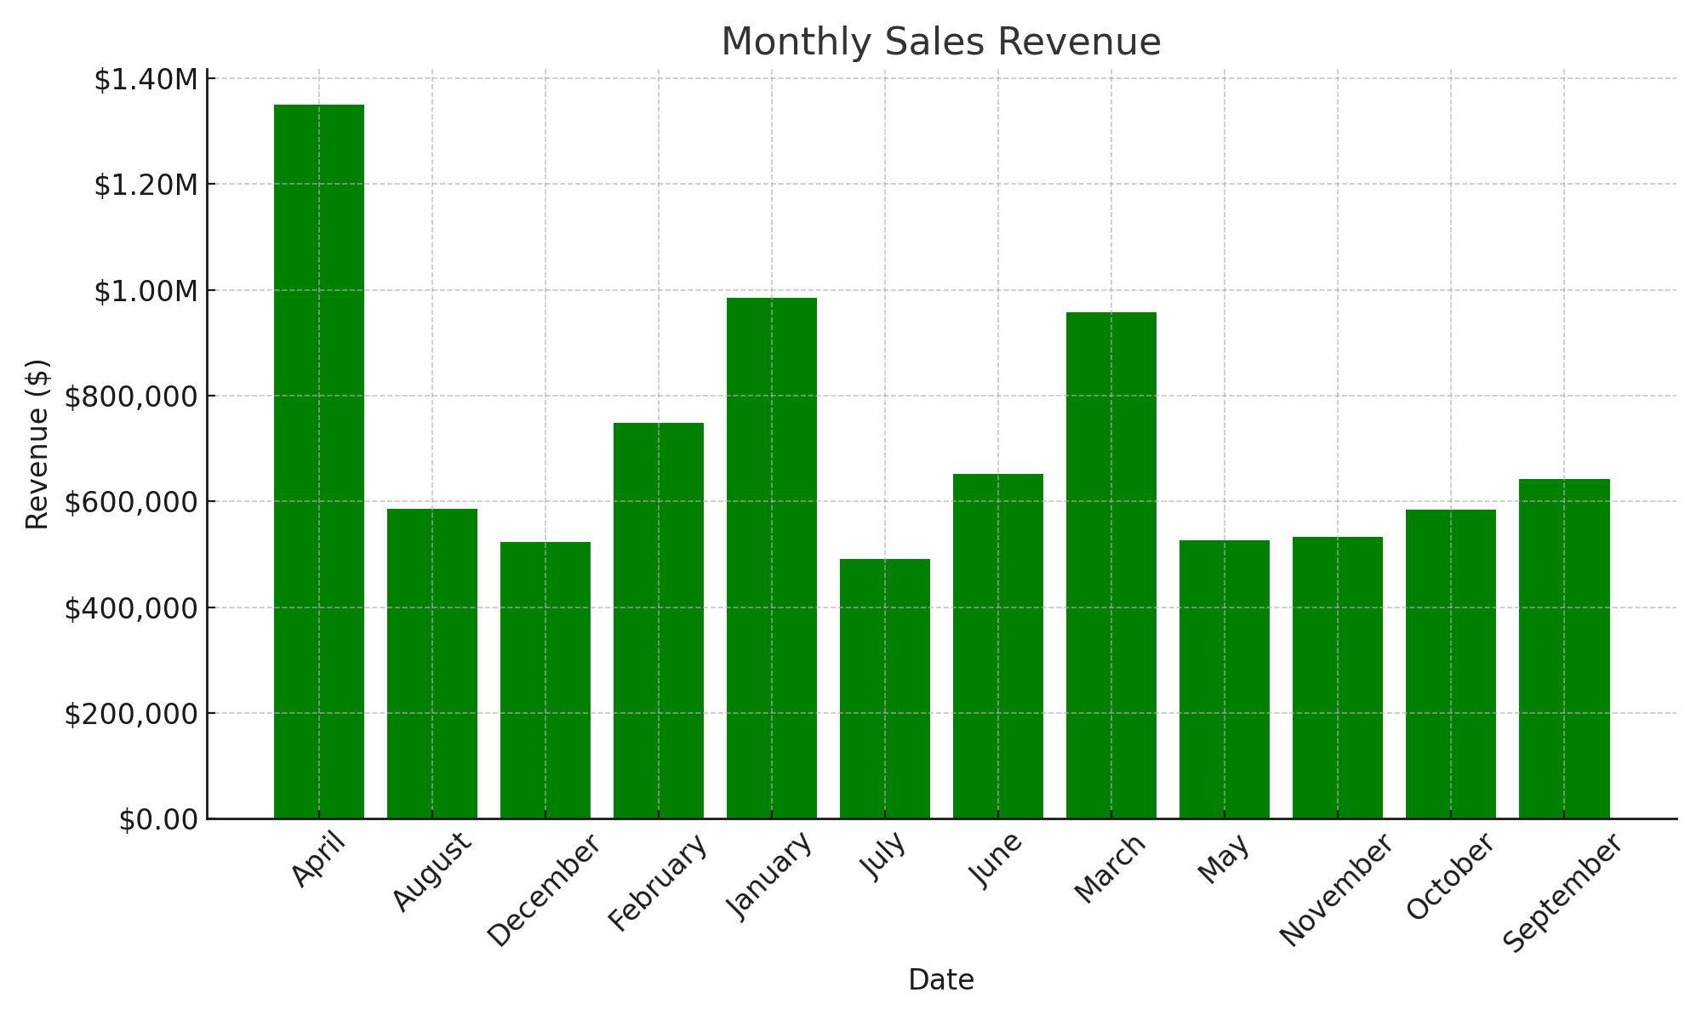
Monthly Sales Revenue
.

Slide 11
Top Categories by Revenue

Slide 12
Some Key Performance Indicators (KPIs)
Total Revenue by Products (Top Categories):
Cyclocross Bicycles: $799,874
Comfort Bicycles: $438,506
Children Bicycles: $327,888
Revenue by Brand:
Trek: $5,129,381
Electra: $1,344,143
Surly: $1,063,135
Total Revenue by Store :
• Baldwin Bikes: $5,826,242
Santa Cruz Bikes: $1,790,145
Rowlett Bikes: $962,600
Top 3 Customers by Revenue:
Elinore Aguilar: $29,661
Corrina Sawyer: $29,214
Shena Carter: $27,618

Slide 13
Conclusion and Recommendations
The analysis of the Bike Store's sales performance across various dimensions reveals several key insights :
•Yearly Sales Growth: The store witnessed remarkable growth in 2017, with a sharp increase in revenue compared to 2016. However, the decline in 2018 suggests that the momentum was not sustained. This calls for a strategic review of the factors that contributed to the growth and the subsequent decline, such as market trends, customer engagement, or inventory management.
•Seasonality in Monthly Sales: The data highlights strong sales in January and February, followed by a gradual dip during the mid-year months. This pattern indicates a seasonal trend in customer demand. The low sales during the summer months present an opportunity for targeted campaigns and promotions aimed at boosting sales during traditionally slower periods.
•State and Store Performance: New York and California dominate the sales distribution, with Baldwin Bikes emerging as the top-performing store. This demonstrates the potential for expanding the brand’s presence in other states with lower sales. Focusing on underperforming regions and leveraging the success of stores like Baldwin Bikes could lead to higher overall revenue.
•Top Products and Brands: Cyclocross and Comfort bicycles are the leading revenue drivers in terms of product categories. Among brands, Trek stands out as the top performer. This suggests that both product and brand-specific marketing strategies could drive further growth, particularly by emphasizing these high-demand categories and leveraging strong brand recognition.
Recommendations:
•Revitalize Sales Growth in 2018: Investigate the factors behind the drop in revenue and develop strategies to reignite growth, such as targeted marketing campaigns, customer retention programs, and expansion into new customer segments.
•Capitalize on Seasonal Trends: Use the strong demand in the early months of the year to drive sales during the quieter summer months through promotions, product launches, or limited-time offers. Engaging customers during this period could even out revenue fluctuations.
•Expand in Underperforming Regions: While New York and California are strong performers, there is significant potential to grow sales in underperforming states. Tailored regional marketing strategies and partnerships with local businesses could increase customer penetration.
•Leverage Top-Performing Stores and Brands: Baldwin Bikes and Trek are clear leaders in store and brand performance, respectively. Consider using these top performers as benchmarks for improving operations at other stores and increasing the focus on high-performing brands.

